Slide 1
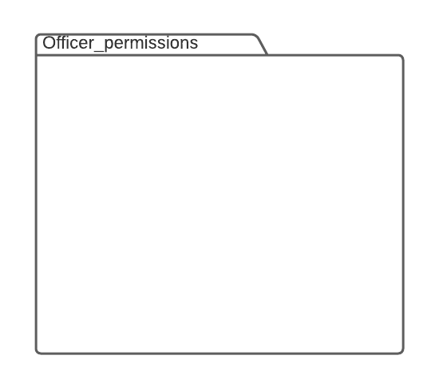

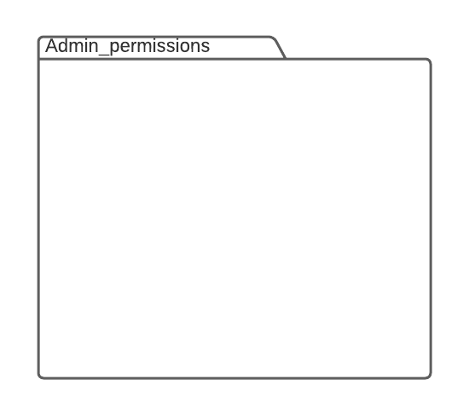
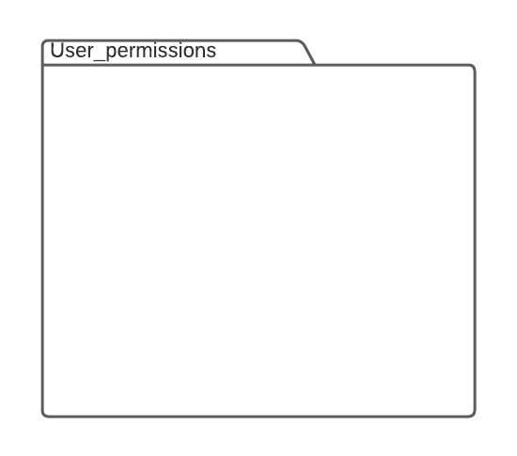
view if the rejected
Requests are corrected or not
View Requests status
Check new requests
Accept requests
Add Officers
Officer
<<extend>>
Send correction request
Reject requests
Data is not correct
Update Officers
<<include>>
Admin
View Reports
View Requests status
view Request status and show the correction requests if exist
Update member
User
Send request
<<include>>
<<include>>
Add member

